Slide 1
Engaging Patient and Community Partners to Advance
Meaningful Research
Jane Gunther, PhD, DABT
Science Officer, cureCADASIL
Co‑Principal Investigator, CZI PPC Grant with Dr. Fanny Elahi
June 27, 2026

Slide 2
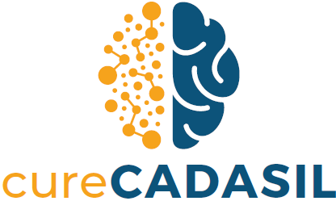
CADASIL research needs the patient voice and shared priorities
• Early research has followed a top‑down model with limited stakeholder involvement.
• Trial‑readiness efforts have not been shaped by patient, family, caregiver priorities.
• Many patients want to contribute but don’t see a path toward future clinical trials.
• Investigators want patient input but lack a structured way to gather it.
• Without coordinated engagement, the field cannot identify patient‑centered priorities for future trials.

Slide 3
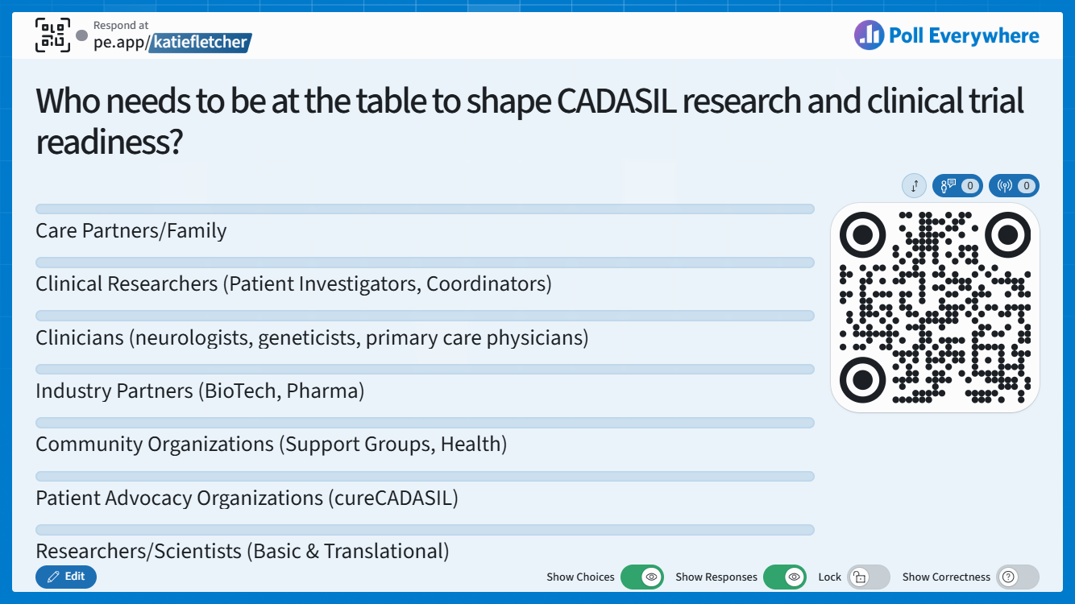
Scan the QR code and choose all the stakeholder groups you believe need to have a voice as research accelerates toward clinical trials (you may select more than one).

Slide 4
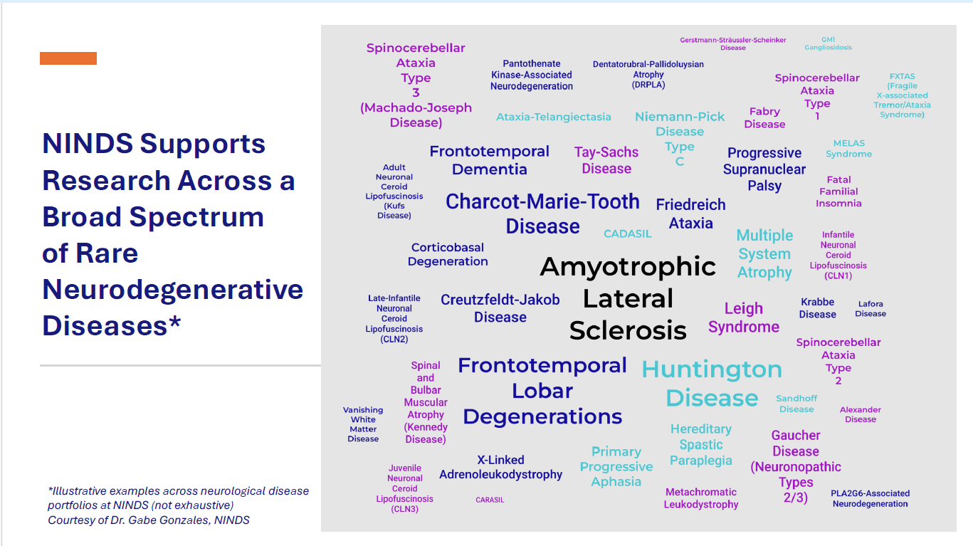

Where CADASIL sits within the larger NINDS landscape

Slide 5
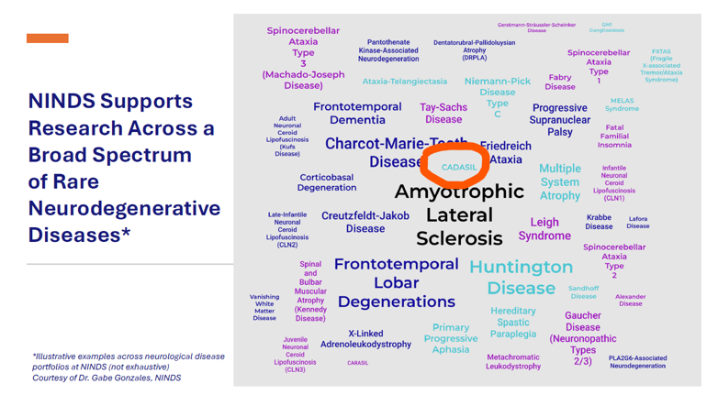
Where CADASIL sits within the larger NINDS landscape

Slide 6
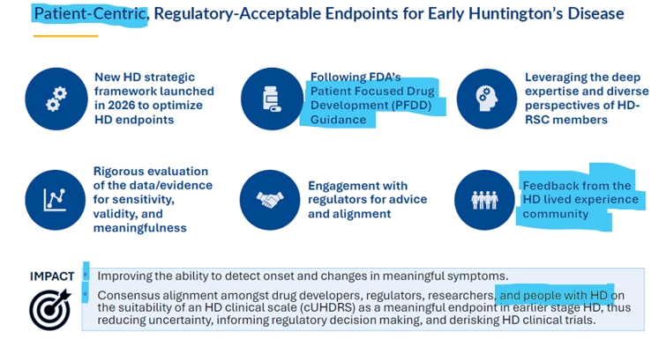
What Does Patient‑Partnered Research Look Like?
Slide presented by Terina Martinez, PhD, Executive Director, Huntington’s Disease Regulatory Science Consortium (HD-RSC), Critical Path Institute. “Updates from CP-RND: Huntington’s Disease (HD)”, June 5, 2026.
Notes:
Engaging with regulators and funders early; Creating capacity for multi‑stakeholder decision‑making; Following patient‑focused research principles
Integrating lived experience into research priorities; Ensuring data and endpoints reflect what matters to patients

Slide 7
Where We Are on the Path Toward Patient‑Partnered Collaborative Research
We began by listening to the community. The international CAG survey — conducted with Dr. Elahi’s lab, the cureCADASIL Community Advisory Group & leadership, and funded through our CZI grant — led to a 2026 publication* that provided an initial foundation for understanding patient‑reported outcomes and priorities for future trials.
We learned from peers who have completed stakeholder‑engaged research. Through the CZI network, we connected with an organization who had partnered with Dr. Evon and the PaCER team at UNC, giving us a clear example of what meaningful, structured engagement can look like and leading us to collaborate with the UNC team.
We are building a model to guide future patient‑centric research and clinical trial readiness. The UNC team’s experience preparing stakeholders to be equal partners in clinical trial readiness is shaping our next steps and will help us build a CADASIL‑specific process for defining meaningful endpoints.
*Defining patient‑reported outcomes and priorities for clinical trials in CADASIL through an international survey. Nikolaos Karvelas, Sheila Connor, Andria Burroso, Ki Coale, Mariana Lemos Duarte, Yuguang Xiong, Liqhwa Ncube, Claudia Kunney, Debarag Banerjee, Michael Kennedy, Sarah McDaniels, Pedro de Lencastre, Jane Gunther, Bert Kasiske, and Fanny M. Elahi.
Published in Cerebral Circulation – Cognition and Behavior, 2026.

Slide 8
Building Our Patient and Community Engagement in Research Program
Borrowing from the University of North Carolina’s Patient and Community Engagement in Research (PaCER) group, we are building a program designed to:
Help stakeholders understand their role in research
Give them the tools to articulate what matters most
Create local meetings where stakeholders come together to share perspectives
Build clear pathways for collaboration across stakeholders
Prepare our community for clinical trials
Ensure the patient voice informs the people designing the future of CADASIL care
This is meaningful, translational work — and the patient community's insights are essential to doing it well.

Slide 9

Designing a Stakeholder‑Partnered Approach to Research and Trial Readiness
In collaboration with Dr. Evon, PaCER, Dr. Elahi, and the CADASIL Consortium
Goal:
Developed in collaboration with Dr. Evon, the PaCER team, Dr. Elahi, and the CADASIL Consortium, this project is designed to create a sustained, coordinated process for capturing and integrating CADASIL stakeholder perspectives to guide patient‑centered research and future clinical trials.
Design:
Local Stakeholder Meetings
Convene diverse stakeholder groups at seven CADASIL Consortium sites + Mount Sinai
Hold in‑person sessions to share perspectives, identify needs, and define priorities
Training Session
Provide virtual training to strengthen stakeholders’ ability to engage in patient‑centered research and trial readiness
Consensus Meeting
Bring representatives together in a final consensus meeting to refine and integrate insights and produce coordinated recommendations for patient‑centered research and future clinical trials.

Slide 10

What Happens Next
PCORI Letter of Intent submission for Capacity Building grant: October 1, 2026
  Highly competitive - up to $300,000 over 2 years
  Builds skills, structure, and readiness for stakeholder‑partnered research
Starting capacity‑building work now — including preparing stakeholders for future engagement activities
Encouraging full participation in cureCADASIL’s registry as part of ongoing patient participation in research
Local stakeholder meeting with Dr. Elahi at Mount Sinai in the Fall – in early planning

Slide 11
Where We Go From Here
What we are building together is capacity — real capacity — for the CADASIL community to participate fully as stakeholders
• We are taking the foundation built with the CZI grant and preparing to expand it to additional investigators who are interested in coordinated, stakeholder‑partnered work with cureCADASIL — strengthening the patient voice and shared learning
• We are preparing to move into coordinated, multi‑stakeholder discussions that will guide future research and trial readiness
Thank you for being part of shaping where we go next

Slide 12
